Slide 1
Lane Departure Warning system DEVELOPMENT
October 23 Meeting Slides

Slide 2
outline
Updates on the vision algorithms:
Hessian point detector and RANSAC
Canny edge detector and Hough transform
Updates on the simulated lane-departure determination

Slide 3
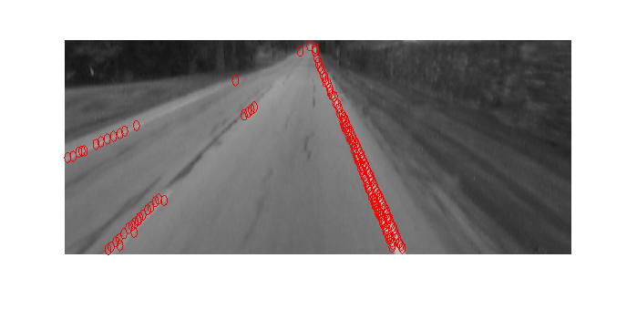
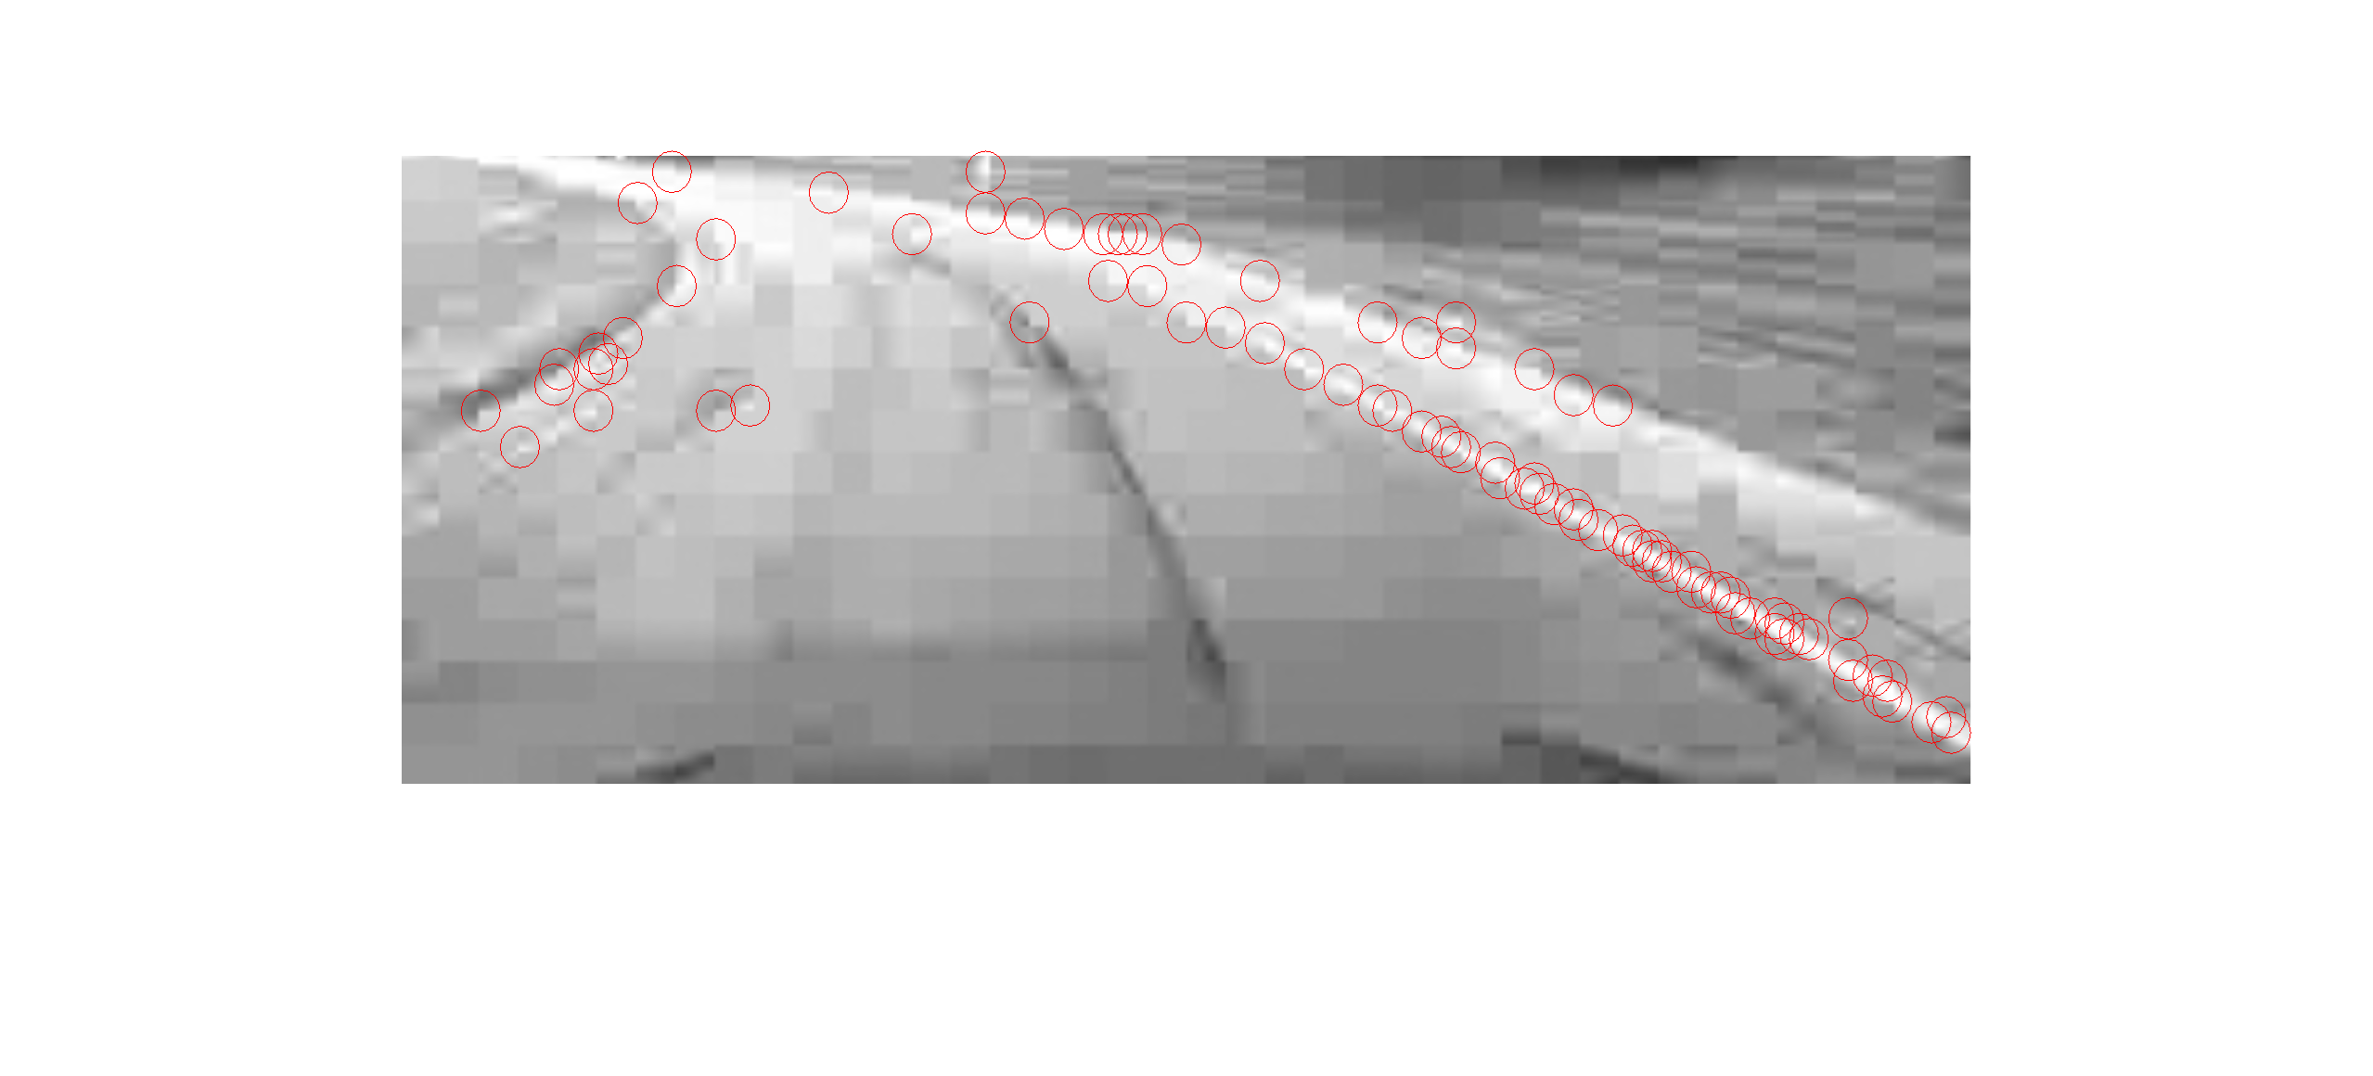
Hessian Point Detector
Gaussian Filter Smoothing Step
Find Hessian Matrix for every pixel in the image
Find the determinant of the Hessian Matrix
Apply Non- maximum Suppression using a 3x3 window on the whole image
Apply a threshold to filter out determinant values

Slide 4
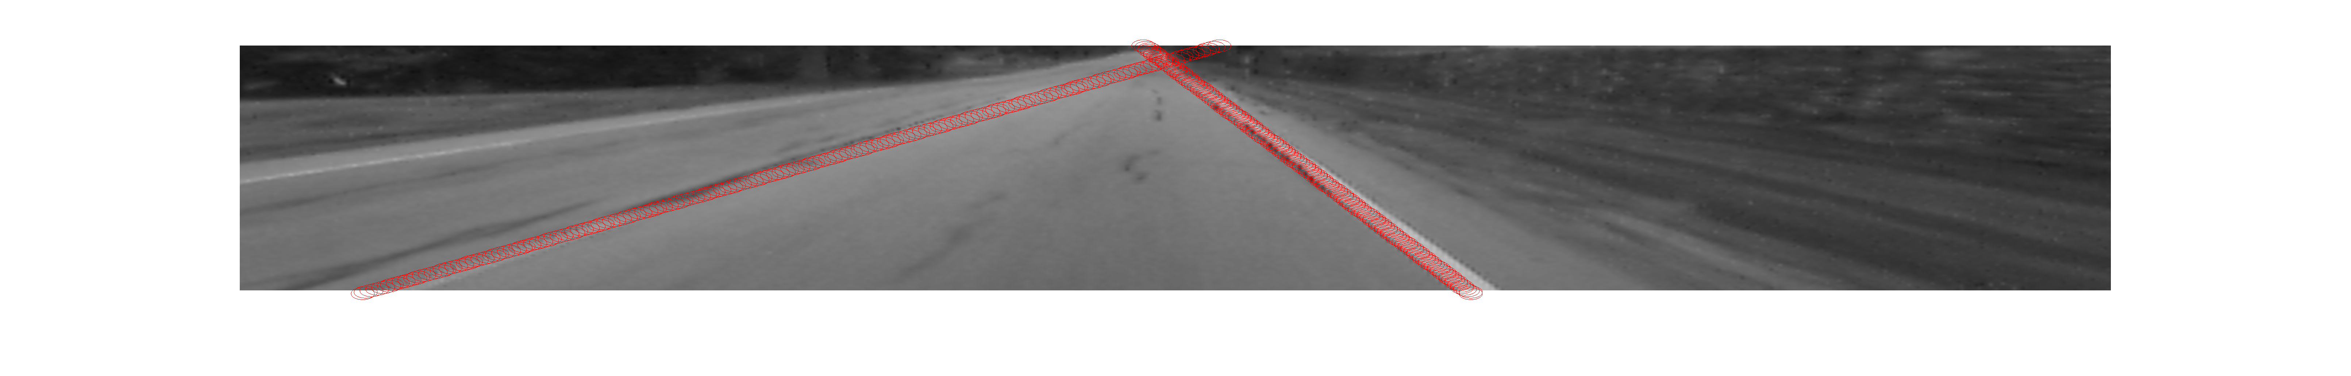
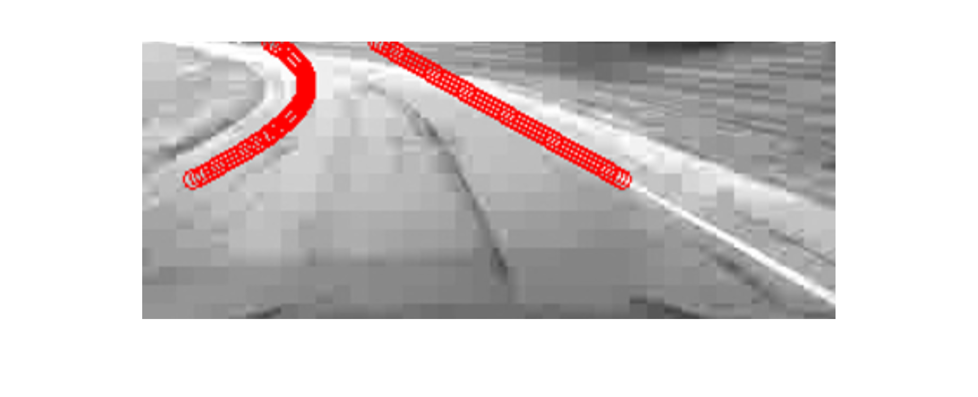
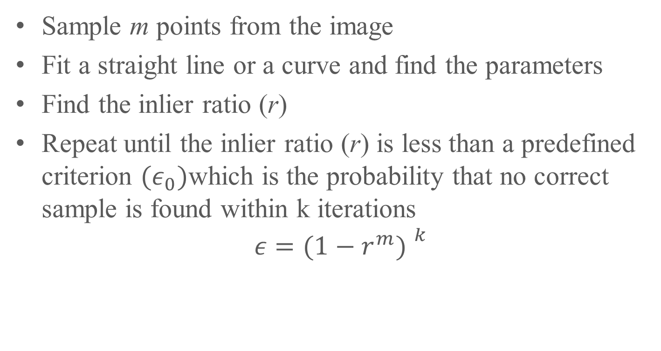
RANSAC
Sample m points from the image
Fit a straight line or a curve and find the parameters
Find the inlier ratio (r)
Repeat until the inlier ratio (r) is less than a predefined criterion ${(ε}_{0})$which is the probability that no correct sample is found within k iterations
$$ε=({1−r^{m}) }^{k}$$

Slide 5
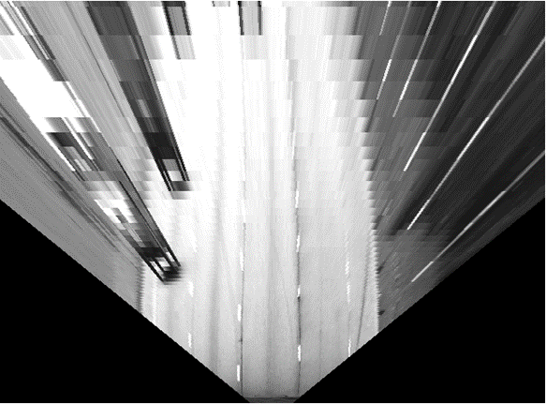
Inverse Perspective Mapping
Image to Ground Coordinate Transformation
Pinhole Camera (Perspective Projection) Model

Slide 6
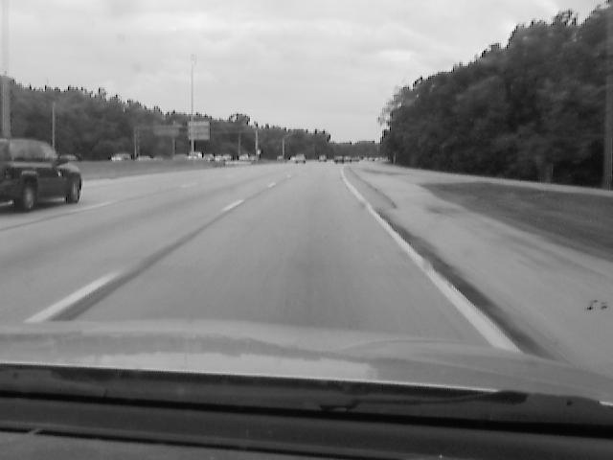
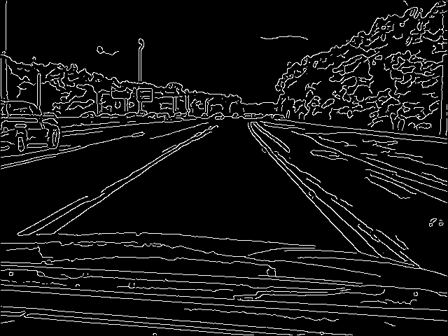
Canny Edge Detector
Multi-Stage algorithm:
Gaussian blur
Calculate gradients
Non-maximum suppression
Hysteresis thresholding
Aims to find ‘true edges’ with noise resistance and minimal response

Slide 7
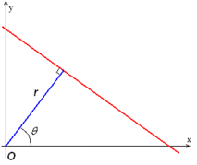
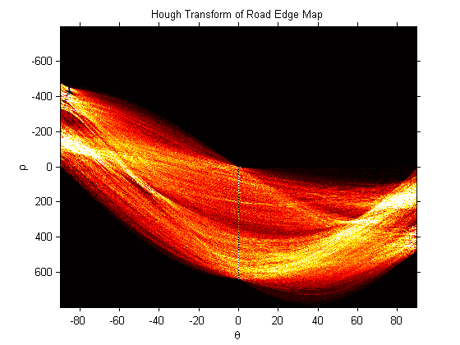
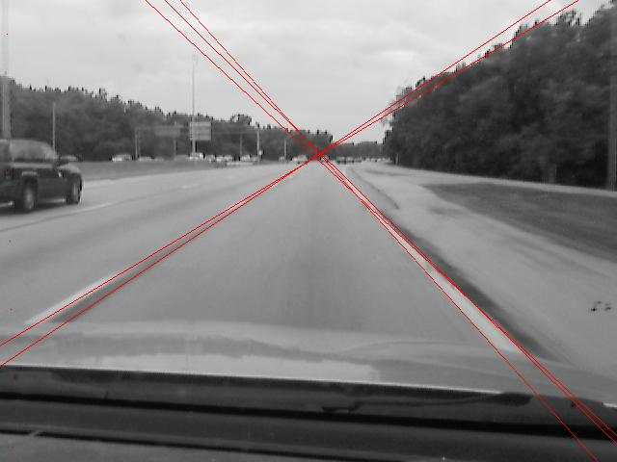
Pruned Hough Transform
Input: Binary Edge Map
Binning operation where each edge point ‘votes’ for every possible line that passes through it
Prune Hough Space to exclude lines that are too horizontal
Peaks in the Hough Space correspond to line with most points
Output: Line Parameters (rho/theta)
Detect left and right lane peaks separately
Confidence:
Currently only spatial
Compares number of detected edge points to an “ideal” lane line

Slide 8
LDW Control Models
Lane Offset Model
Warning sounds when current lane offset passes certain thresholds
Bicycle Model
Model predicts the future lane offset of the vehicle using dynamic equations, and a warning sounds when this passes certain thresholds
Curve calculation model - new
Thresholds are set based on the model and sensitivity level.

Slide 9
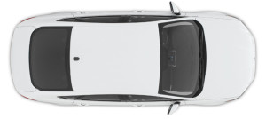
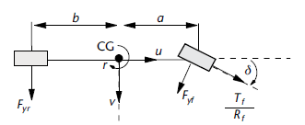
calculation
Simple lane offset
Bicycle
warning threshold
lane marker
prediction horizon
warning threshold
lane marker

Slide 10
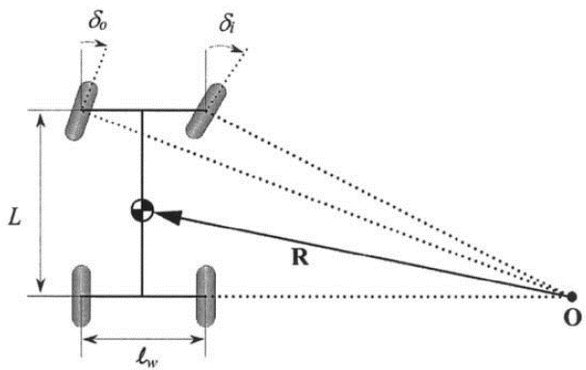
Curve Prediction
Model calculates the turning radius based on the turning angle of the steering wheel and length of the vehicle.
Turning Radius, Yaw Error, and Speed are then used to predict the vehicle’s position in the lane one second in the future.
Turning Geometry [6]

Slide 11
Suppression
All three models suppress lane departure warnings under the following conditions:
Speed < 15.7 m/s (~35mph)
Steering Angle > ±0.4 rad (23⁰)
(Sharper turns imply intent to turn on the driver’s part)
Lateral Speed opposes lane divergence
(Opposing lateral speed signals driver’s intent to correct their error)
Turn Signal verifies lane divergence
Acceleration threshold (to be implemented)
Other suppression signals as required

